Slide 1
Chapter 15 – Cluster Analysis
Data Mining for Business Analytics in Python
Shmueli, Bruce, Gedeck & Patel

Slide 2
Clustering: The Main Idea
Goal: Form groups (clusters) of similar records
Used for segmenting markets into groups of similar customers
Example: Over 50 years ago, Claritas segmented US neighborhoods based on demographics & income: “Furs & station wagons,” “Money & Brains”, …

Slide 3
Other Applications
Periodic table of the elements
Classification of species
Grouping securities in portfolios
Grouping firms for structural analysis of economy
Army uniform sizes
Segments of voters

Slide 4
Example: Public Utilities
Goal: find clusters of similar utilities
Data: 22 firms, 8 variables
Fixed-charge covering ratio
Rate of return on capital
Cost per kilowatt capacity
Annual load factor
Growth in peak demand
Sales
% nuclear
Fuel costs per kwh

Slide 5
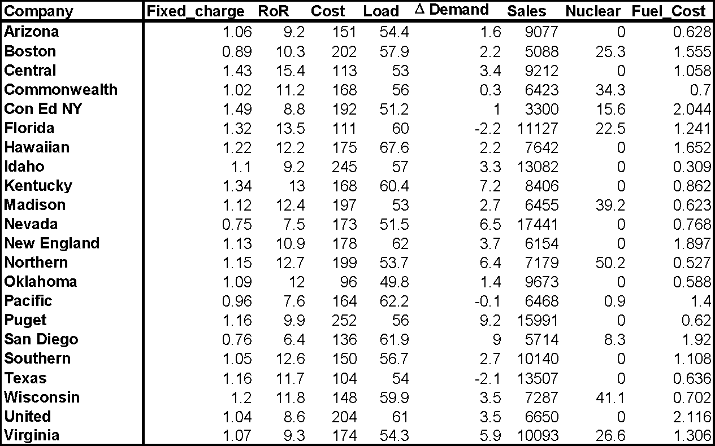

Slide 6
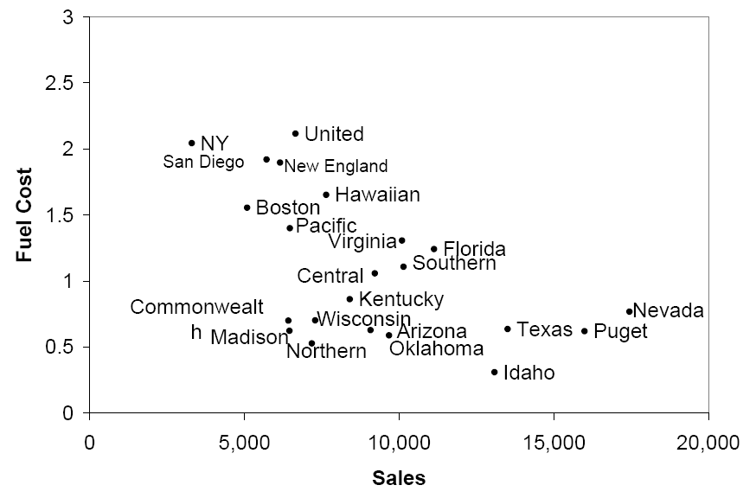
Sales & Fuel Cost:
3 rough clusters can be seen
High fuel cost, low sales
Low fuel cost, high sales
Low fuel cost, low sales

Slide 7
Extension to More Than 2 Dimensions
In prior example, clustering was done by eye
Multiple dimensions require formal algorithm with
A distance measure
A way to use the distance measure in forming clusters
We will consider two algorithms: hierarchical and non-hierarchical

Slide 8
Measuring Distance
Between records
Between clusters

Slide 9
Measuring Distance Between Records
Notes:
‹#›

Slide 10
Distance Between Two Records
Euclidean Distance is most popular:
Notes:
‹#›

Slide 11
Compute Distance Matrix for Utility Pairs
utilities_df = pd.read_csv('Utilities.csv')
# set row names to the utilities column
utilities_df.set_index('Company', inplace=True)
# compute Euclidean distance
d = pairwise.pairwise_distances(utilities_df,
metric='euclidean')
pd.DataFrame(d, columns=utilities_df.index,
index=utilities_df.index)

Slide 12
Output: Distance Matrix for Utility Pairs
Partial Output
Company Arizona Boston Central Commonwealth NY
Company
Arizona 0.000000 3989.408076 140.402855 2654.277632 5777.167672
Boston 3989.408076 0.000000 4125.044132 1335.466502 1788.068027
Central 140.402855 4125.044132 0.000000 2789.759674 5912.552908
Commonwealth 2654.277632 1335.466502 2789.759674 0.000000 3123.153215
NY 5777.167672 1788.068027 5912.552908 3123.153215 0.000000

Slide 13
Normalizing
Problem: Raw distance measures are highly influenced by scale of measurements
Solution: normalize (standardize) the data first
Subtract mean, divide by std. deviation
Also called z-scores
Or Rescale to 0/1 range
Subtract the minimum
Divide by range

Slide 14
Example: Normalization
For 22 utilities:
Avg. sales = 8,914
Std. dev. = 3,550
Normalized score for Arizona sales:
(9,077-8,914)/3,550 = 0.046

Slide 15
Code for Normalizing then Computing Distance
# using scikit-learn*
utilities_df_norm = utilities_df.apply(preprocessing.scale,
axis=0)
# using pandas*
utilities_df_norm = (utilities_df -
utilities_df.mean())/utilities_df.std()
# compute normalized distance based on Sales and Fuel Cost
utilities_df_norm[['Sales', 'Fuel_Cost']]
d_norm = pairwise.pairwise_distances
(utilities_df_norm[['Sales', 'Fuel_Cost']],
metric='euclidean')
pd.DataFrame(d_norm, columns=utilities_df.index,
index=utilities_df.index)
*scikit-learn uses population std. dev. (divide by n), pandas uses sample std. dev. (divide by n-1)

Slide 16
Distance Matrix - Normalized
Partial output
Company Arizona Boston Central Commonwealth NY
Company
Arizona 0.000000 2.010329 0.774179 0.758738 3.021907
Boston 2.010329 0.000000 1.465703 1.582821 1.013370
Central 0.774179 1.465703 0.000000 1.015710 2.432528
Commonwealth 0.758738 1.582821 1.015710 0.000000 2.571969
NY 3.021907 1.013370 2.432528 2.571969 0.000000

Slide 17
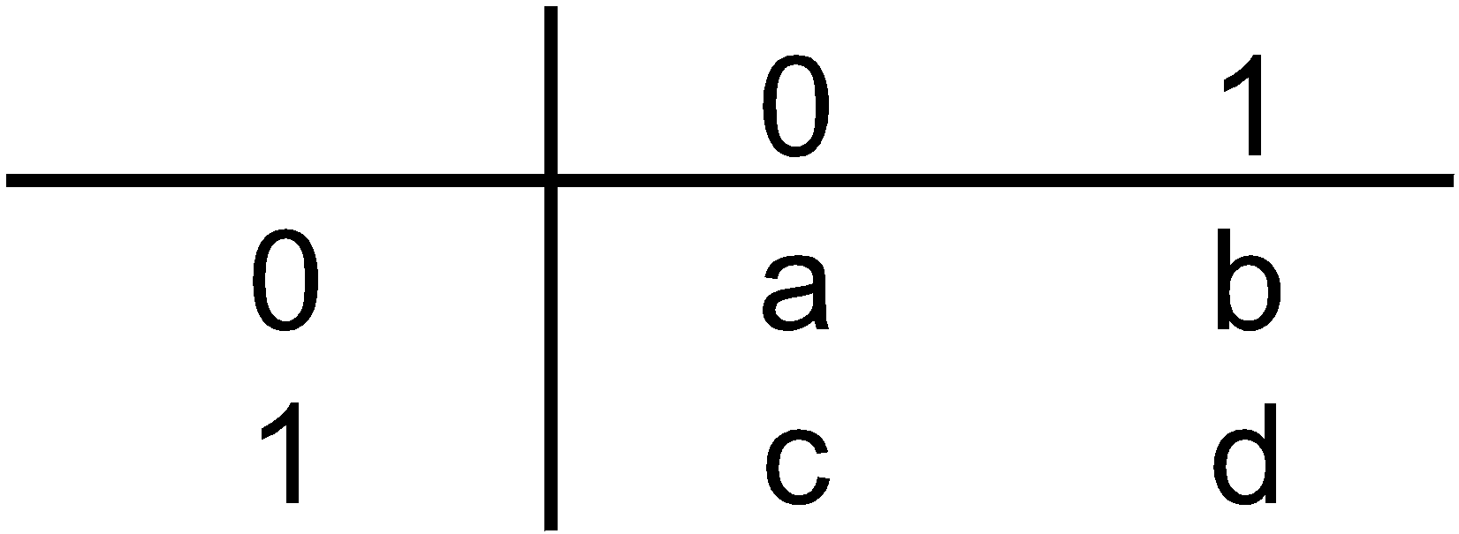
For Categorical Data: Similarity
To measure the distance between records in terms of two 0/1 variables, create table with counts:
Similarity metrics based on this table:
Matching coef. = (a+d)/p
Jaquard’s coef. = d/(b+c+d)
Use in cases where a matching “1” is much greater evidence of similarity than matching “0” (e.g. “owns Corvette”)

Slide 18
Other Distance Measures
Correlation-based similarity
Statistical distance (Mahalanobis)
Manhattan distance (absolute differences)
Maximum coordinate distance
Gower’s similarity (for mixed variable types: continuous & categorical)

Slide 19
Measuring Distance Between Clusters

Slide 20
Minimum Distance (Cluster A to Cluster B)
Also called single linkage
Distance between two clusters is the distance between the pair of records A_{i} and B_{j} that are closest

Slide 21
Maximum Distance (Cluster A to Cluster B)
Also called complete linkage
Distance between two clusters is the distance between the pair of records A_{i} and B_{j} that are farthest from each other

Slide 22
Average Distance
Also called average linkage
Distance between two clusters is the average of all possible pair-wise distances

Slide 23
Centroid Distance
Distance between two clusters is the distance between the two cluster centroids.
Centroid is the vector of variable averages for all records in a cluster

Slide 24
Hierarchical Methods
Agglomerative Methods
Begin with n-clusters (each record its own cluster)
Keep joining records into clusters until one cluster is left (the entire data set)
Most popular
Divisive Methods
Start with one all-inclusive cluster
Repeatedly divide into smaller clusters

Slide 25
Hierarchical Clustering

Slide 26
The Hierarchical Clustering Steps (Using Agglomerative Method)
Start with n clusters (each record is its own cluster)
Merge two closest records into one cluster
At each successive step, the two clusters closest to each other are merged
Dendrogram, from bottom up, illustrates the process

Slide 27
Code for Hierarchical Clustering and Plotting the Dendrogram
Single and Average Linkage
# in linkage() set argument method =
# 'single', 'complete', 'average', 'weighted', centroid', # 'median', 'ward'
Z = linkage(utilities_df_norm, method='single')
dendrogram(Z, labels=utilities_df_norm.index, color_threshold=2.75)
Z = linkage(utilities_df_norm, method='average')
dendrogram(Z, labels=utilities_df_norm.index, color_threshold=3.6)

Slide 28
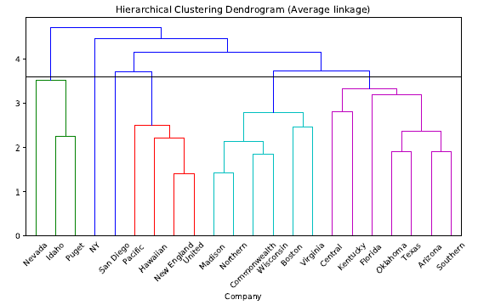
Dendrogram for Average Linkage
two closest records form first cluster

Slide 29
Reading the Dendrogram
See process of clustering: Lines connected lower down are merged earlier
New England and United will be merged first, then Madison and Northern
Determining number of clusters: For a given “distance between clusters”, a horizontal line intersects the clusters that are that far apart, to create clusters
At distance of 3.6 (horizontal line in the slide) data can be reduced to 6 clusters – 2 singletons, and 4 clusters

Slide 30
Finding Cluster Membership
Average Linkage (output modified for clarity)
> memb = fcluster(linkage(utilities_df_norm,
method='average'), 6, criterion='maxclust')
> memb = pd.Series(memb, index=utilities_df_norm.index)
> for key, item in memb.groupby(memb):
> print(key, ': ', ', '.join(item.index))
1 : Idaho, Nevada, Puget
2 : Hawaiian, New England, Pacific, United
3 : San Diego
4 : Boston, Commonwealth, Madison, Northern, Wisconsin, Virginia
5 : Arizona, Central, Florida, Kentucky, Oklahoma, Southern, Texas
6 : NY

Slide 31

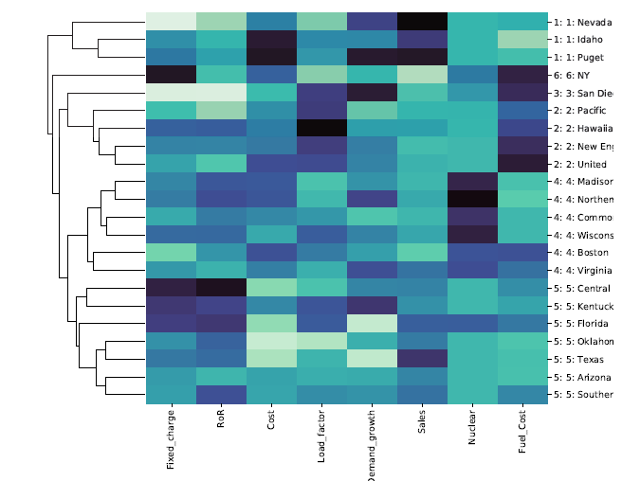
Visualize Cluster Features with Heatmap
darker = higher values

Slide 32
Nonhierarchical Clustering: K-Means Clustering

Slide 33
K-Means Clustering Algorithm
Choose # of clusters desired, k
Start with a partition into k clusters
Often based on random selection of k centroids
At each step, move each record to cluster with closest centroid
Recompute centroids, repeat step 3
Stop when moving records increases within-cluster dispersion

Slide 34
K-means Algorithm: Choosing k and Initial Partitioning
Choose k based on the how results will be used
e.g., “How many market segments do we want?”
Also experiment with slightly different k’s
Initial partition into clusters can be random, or based on domain knowledge
If random partition, repeat the process with different random partitions

Slide 35
Code for K-means Clustering
# Load and preprocess data
utilities_df = pd.read_csv('Utilities.csv')
utilities_df.set_index('Company', inplace=True)
utilities_df = utilities_df.apply(lambda x: x.astype('float64'))
# Normalize distances
utilities_df_norm = utilities_df.apply(preprocessing.scale, axis=0)
kmeans = KMeans(n_clusters=6,
random_state=0).fit(utilities_df_norm)
ask for 6 clusters

Slide 36
Output: K-means Clustering
# Cluster membership
memb = pd.Series(kmeans.labels_, index=utilities_df_norm.index)
for key, item in memb.groupby(memb):
print(key, ': ', ', '.join(item.index))
Output
0 : Commonwealth, Madison , Northern, Wisconsin, Virginia
1 : Boston , Hawaiian , New England, Pacific , San Diego, United
2 : Arizona , Central , Florida , Kentucky, Oklahoma, Southern, Texas
3 : NY
4 : Nevada
5 : Idaho, Puget

Slide 37
Output: K-means Clustering
Cluster Centroids
> centroids = pd.DataFrame(kmeans.cluster_centers_,
columns=utilities_df_norm.columns)
> pd.set_option('precision', 3)
> centroids
Fixed_charge RoR Cost Load_factor Demand_growth Sales Nuclear Fuel_Cost
0 -0.012 0.339 0.224 -0.366 0.170 -0.411 1.602 -0.609
1 -0.633 -0.640 0.207 1.175 0.058 -0.758 -0.381 1.204
2 0.516 0.798 -1.009 -0.345 -0.501 0.360 -0.536 -0.420
3 2.085 -0.883 0.592 -1.325 -0.736 -1.619 0.219 1.732
4 -2.020 -1.476 0.120 -1.257 1.070 2.458 -0.731 -0.616
5 0.088 -0.541 1.996 -0.110 0.988 1.621 -0.731 -1.175

Slide 38
How Tight are the Clusters
# distances of each record to the cluster centers
distances = kmeans.transform(utilities_df_norm)
# find closest cluster for each record
minSquaredDistances = distances.min(axis=1) ** 2
# combine with cluster labels into a data frame
df = pd.DataFrame({'squaredDistance': minSquaredDistances,
'cluster': kmeans.labels_}, index=utilities_df_norm.index)
# group by cluster and print information
for cluster, data in df.groupby('cluster'):
count = len(data)
withinClustSS = data.squaredDistance.sum()
print(f'Cluster {cluster} ({count} members):
{withinClustSS:.2f} within cluster ')
Output
Cluster 0 (5 members): 10.66 within cluster
Cluster 1 (6 members): 22.20 within cluster
Cluster 2 (7 members): 27.77 within cluster
Cluster 3 (1 members): 0.00 within cluster
Cluster 4 (1 members): 0.00 within cluster
Cluster 5 (2 members): 2.54 within cluster

Slide 39
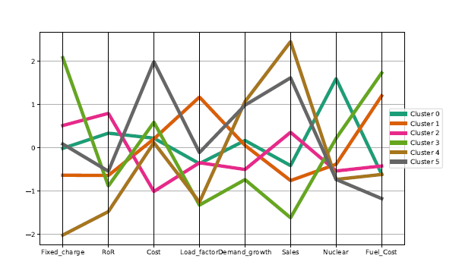
Profile Plot: K-means Clustering
centroids['cluster'] = ['Cluster {}'.format(i) for i in
centroids.index]
plt.figure(figsize=(10,6))
parallel_coordinates(centroids, class_column='cluster',
colormap='Dark2', linewidth=5)
plt.legend(loc='center left', bbox_to_anchor=(1, 0.5))

Slide 40
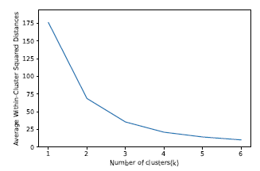
Different Choices for K
As the number of clusters increases, the cluster members are closer to one another.

Slide 41
Validating Clusters

Slide 42
Interpretation
Goal: obtain meaningful and useful clusters
Caveats:
(1) Random chance can often produce apparent clusters
(2) Different cluster methods produce different results
Solutions:
Obtain summary statistics
Also review clusters in terms of variables not used in clustering
Label the cluster (e.g. clustering of financial firms in 2008 might yield label like “midsize, sub-prime loser”)

Slide 43
Desirable Cluster Features
Stability – are clusters and cluster assignments sensitive to slight changes in inputs? Are cluster assignments in partition B similar to partition A?
Separation – check ratio of between-cluster variation to within-cluster variation (higher is better)

Slide 44
Summary
Cluster analysis is an exploratory tool. Useful only when it produces meaningful clusters
Hierarchical clustering gives visual representation of different levels of clustering
On other hand, due to non-iterative nature, it can be unstable, can vary highly depending on settings, and is computationally expensive
Non-hierarchical is computationally cheap and more stable; requires user to set k
Can use both methods
Be wary of chance results; data may not have definitive “real” clusters

